Slide 1
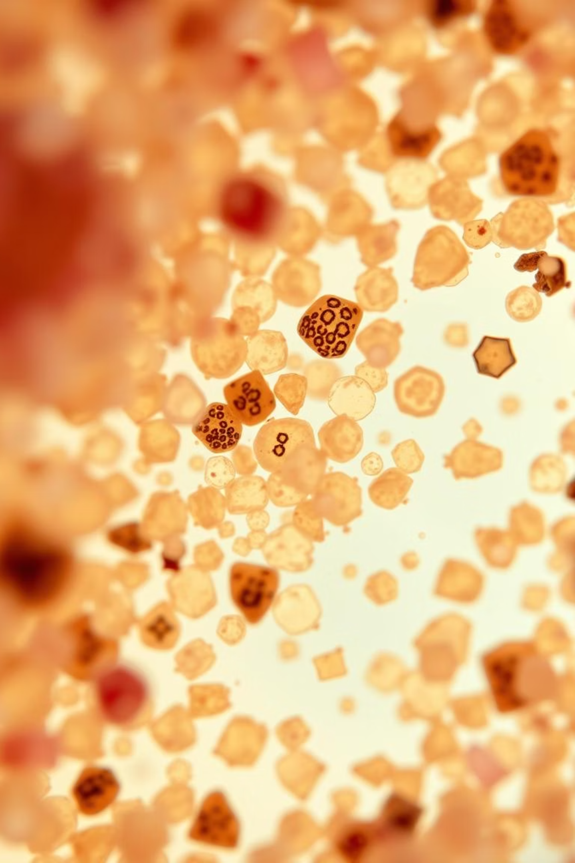
Pollen's Profiling: Automated Classification of Pollen Grains
This presentation will explore how automated classification of pollen grains is revolutionizing palynology through AI-driven image analysis. We will address the significant global allergy burden, with hay fever alone costing the U.S. an estimated $3.4 billion annually, and how current manual, slow, and subjective methods limit effective solutions.
CB
by CHANDU BODELA

Slide 2
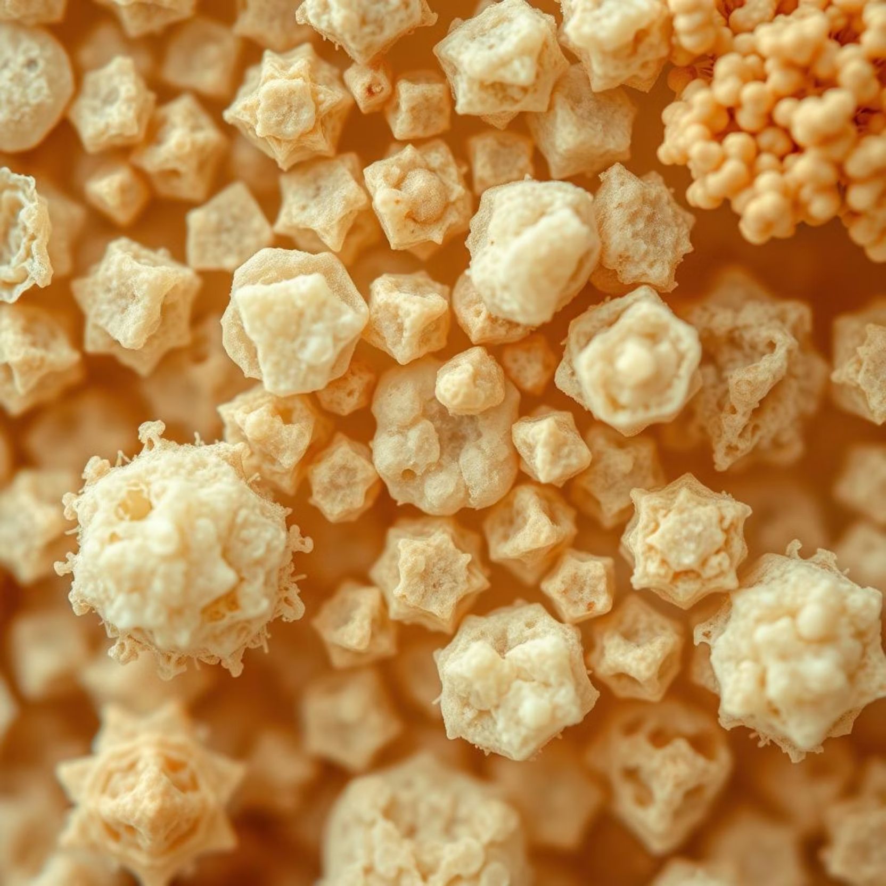
The Microscopic Challenge of Pollen
Pollen grains, ranging from 10 to 200 micrometers, exhibit vast morphological diversity. Their intricate structures make manual identification a microscopic challenge, requiring highly skilled palynologists. This process is painstakingly slow, often taking 30-60 minutes per sample.
Current limitations include low throughput, subjective interpretation, and delayed data, hindering accurate allergy forecasts and slowing environmental research. These inefficiencies also contribute to high labor costs, creating a critical need for automation.

Slide 3

Introducing Automated Pollen Classification
Our solution leverages cutting-edge AI-powered image analysis for rapid and objective pollen identification. The core goal is to dramatically enhance the speed, accuracy, and consistency of pollen analysis, overcoming the limitations of traditional methods.
AI-Powered Analysis
Rapid Processing
Objective Data
Utilizes machine learning and computer vision for precise identification.
Enables high-throughput analysis, previously impossible with manual methods.
Minimizes subjective interpretation, providing consistent and reliable results.

Slide 4
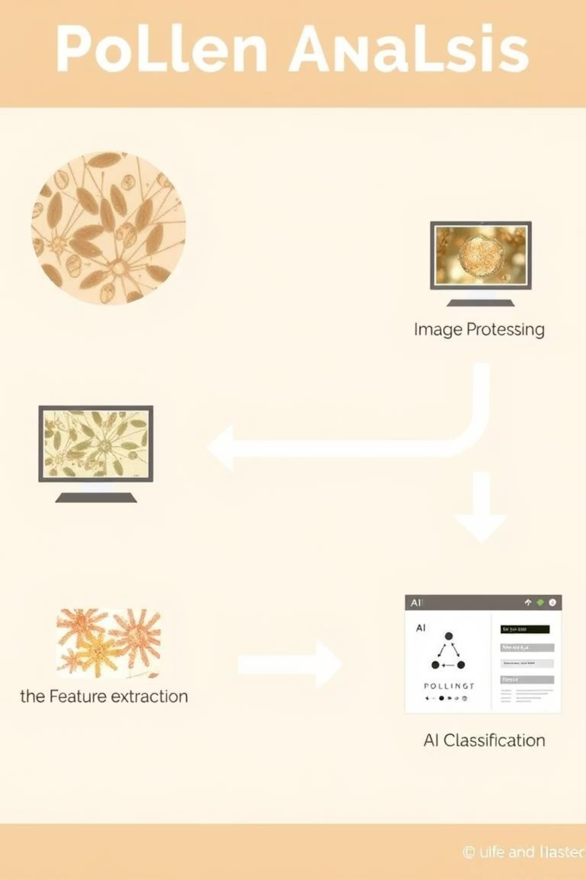




The Automated Workflow: From Sample to Insight
Our automated workflow transforms raw pollen samples into actionable insights through a streamlined, multi-stage process. Each step is designed for precision and efficiency, ensuring high-quality data.
1. Automated Sample Acquisition
High-resolution imaging via automated microscopy captures thousands of pollen grains rapidly.
2. Image Processing
Digital segmentation and enhancement isolate individual grains, preparing them for analysis.
3. Feature Extraction
Automated systems capture morphological (shape, size, apertures) and textural data from each grain.
4. AI Classification
Machine learning models instantly categorize pollen types based on extracted features.

Slide 5

Under the Hood: AI & Advanced Algorithms
Our system is powered by sophisticated AI and advanced algorithms, ensuring unparalleled accuracy and learning capabilities.
Deep Learning: We utilize Convolutional Neural Networks (CNNs) like ResNet and InceptionV3, capable of learning complex visual patterns.
Feature Engineering: The system quantifies precise attributes such as size (e.g., 25-50 µm), shape indices (e.g., circularity 0.85), and surface patterns (e.g., echinate, reticulate).
Training Datasets: Success relies on vast libraries containing thousands of meticulously labeled pollen images, enabling the AI to generalize effectively.
These advanced techniques enable the AI to learn complex patterns and robustly handle variations in grain orientation and focus, delivering consistent results.

Slide 6





Transformative Applications Across Fields
Automated pollen classification offers transformative applications across a diverse range of fields, bringing new levels of precision and efficiency.
Aerobiology & Allergies
Provides real-time airborne pollen counts, improving 3-day allergy forecasts and potentially reducing ER visits by 15%.
Forensic Science
Offers crucial trace evidence, linking suspects or victims to specific geographic locations with up to 90% accuracy.
Apiculture
Verifies honey origin (e.g., Manuka purity) and assesses bee health through detailed analysis of pollen loads.
Paleobotany
Expedites climate reconstruction by enabling analysis of 10x more samples in significantly less time, revealing historical ecosystems.

Slide 7
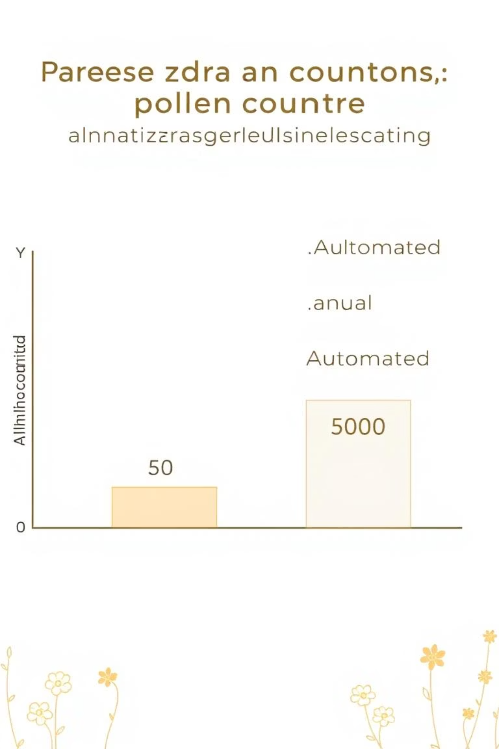
Quantifiable Impact: Real-World Results
The real-world results demonstrate the significant and quantifiable impact of automated pollen classification.
95%
500+
80%
Accuracy
Speed
Efficiency
Achieves over 95% classification accuracy for common pollen types like birch, ragweed, pine, and grass.
Processes more than 500 pollen grains per minute, a dramatic improvement over the 10-20 grains/minute of manual methods.
Reduces analysis time for complex paleobotanical studies by a remarkable 80%, accelerating research.
Our technology is already integrated into automated pollen monitoring networks, such as the European e-pollen network, proving its robust deployment capabilities and effectiveness in critical applications.

Slide 8
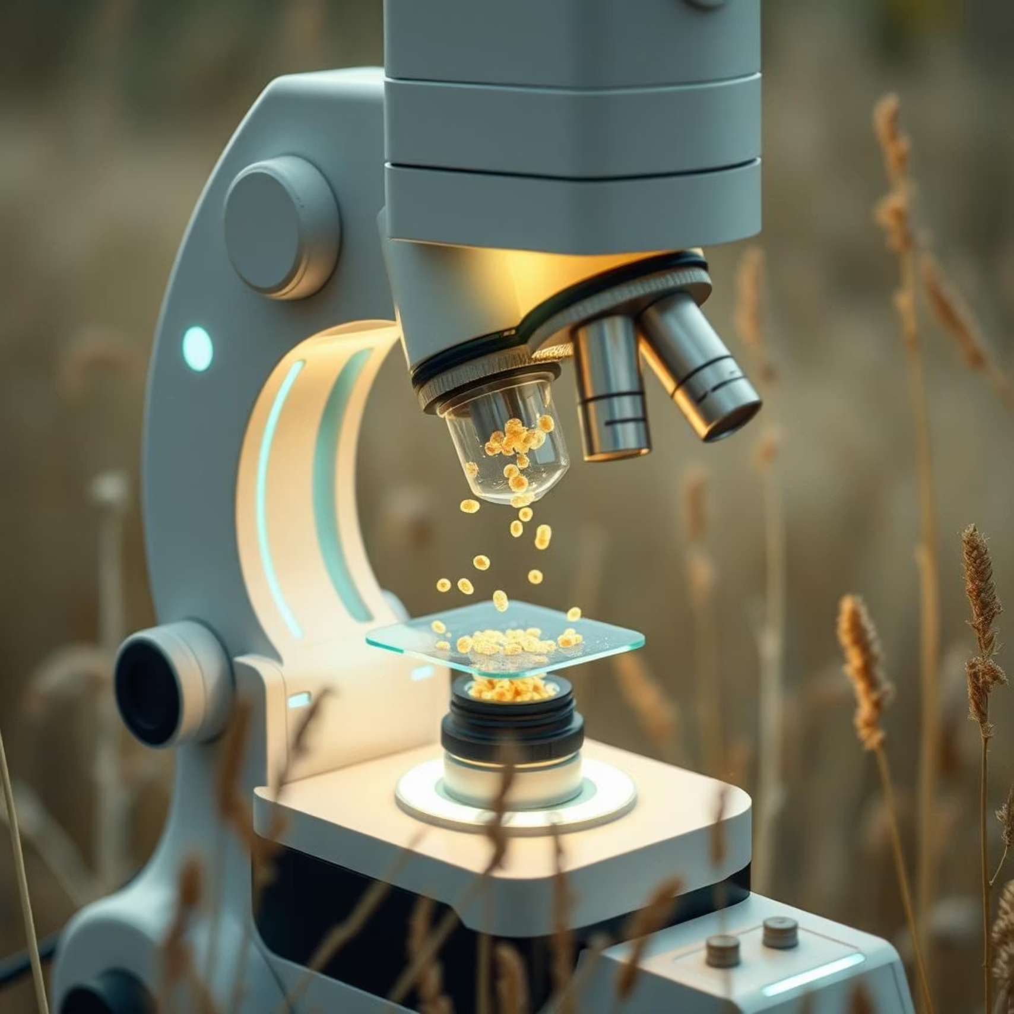
The Future of Palynology: Smarter, Faster, Broader
Pollen's Profiling is poised to become an indispensable tool, driving a new era in environmental, health, and forensic sciences. The journey of innovation continues.
Ongoing Development: We are continuously expanding species coverage, with a goal of classifying over 1000 pollen types, and improving robustness for mixed samples.
Innovation: The emergence of portable, field-deployable automated pollen monitors will democratize access to this technology.
Vision: Our ultimate vision is to democratize palynological expertise globally, enhancing ecological insights and public health initiatives through smart, fast, and broad applications.

